Slide 1
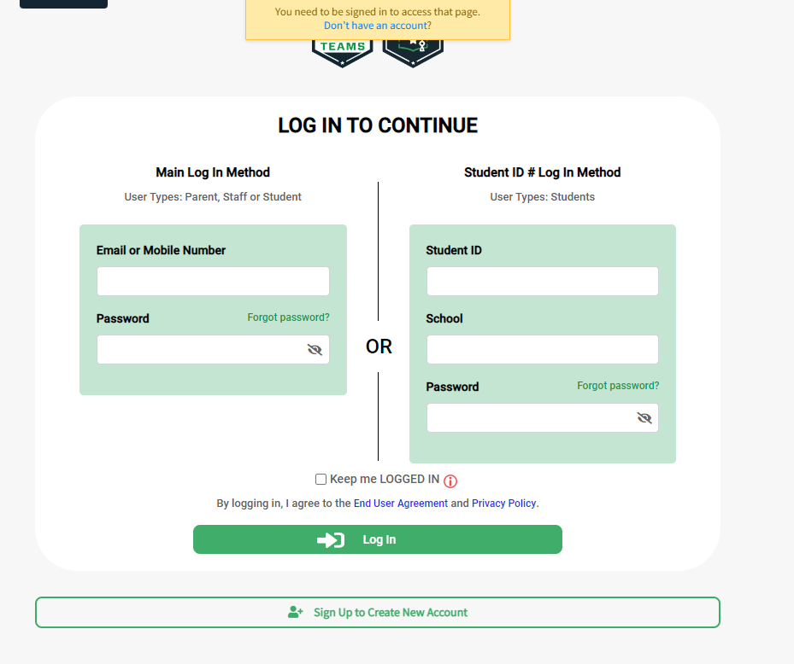
Go to : BigTeams ←Click link
Or search planet high school via Google.

Slide 2
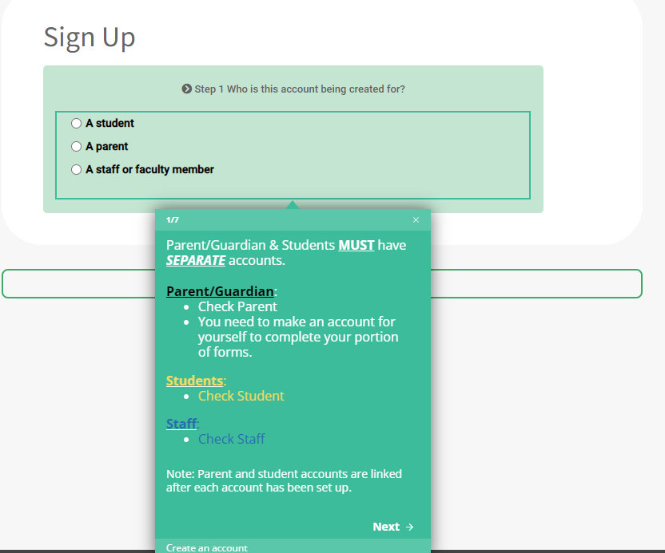
If you have not done so you must register. This can be found at the bottom of the page.

Slide 3
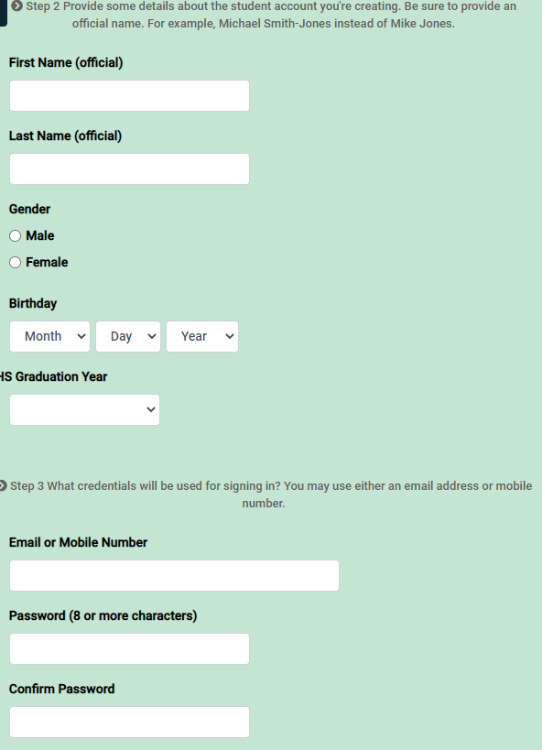
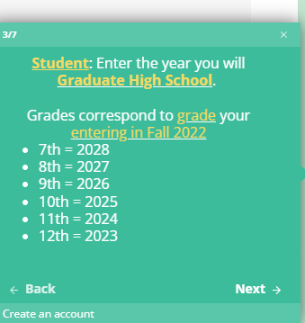
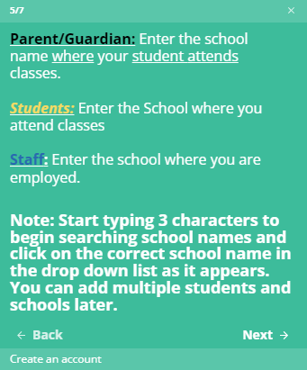
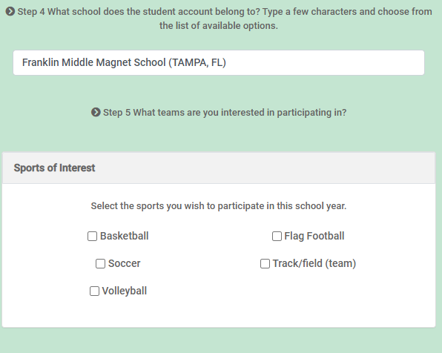
You will have to create a Student Account and a Parent Account.

Slide 4
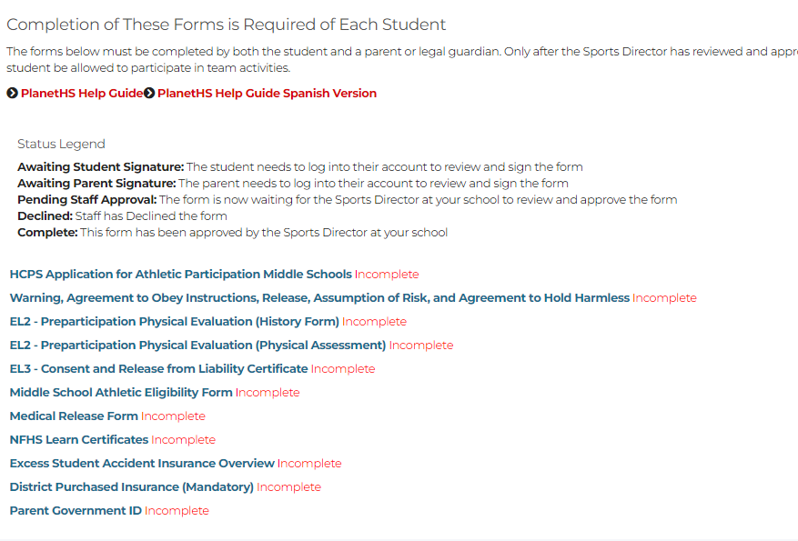
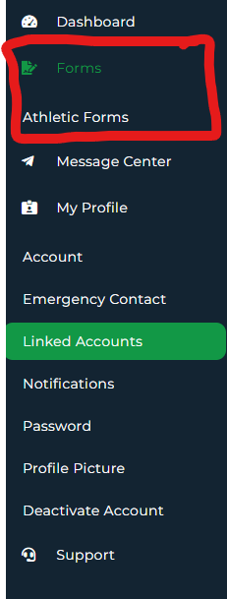
Once you completed sign in process, you will come to the home page. On the left you will see a tool bar: Go to Forms -> athletic forms, in will direct you to the following page

Slide 5
All these forms must be completed and Submitted online. Once submitted Admin will have to approve all forms.

Slide 6
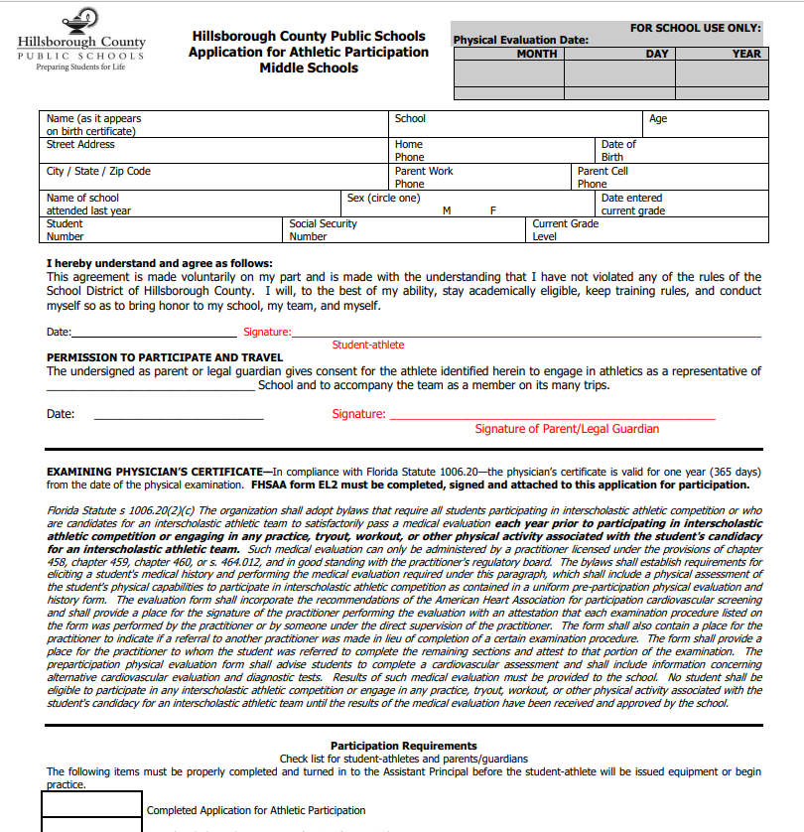
1. HCPS Application for Athletic Participation Middle Schools

Slide 7
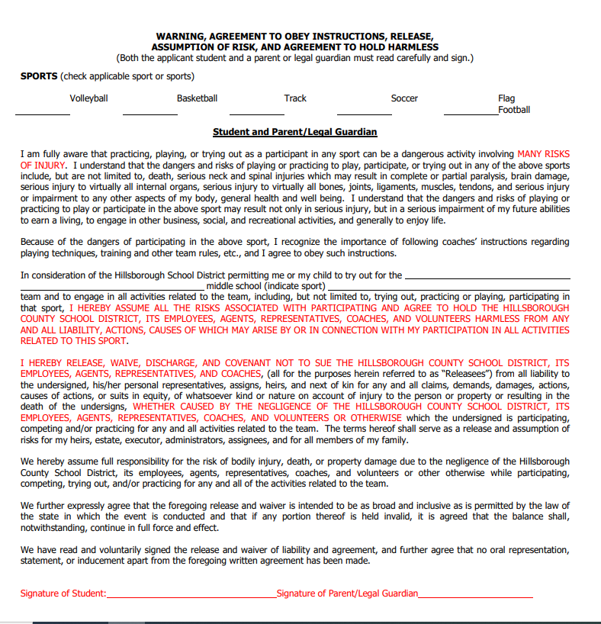
2. Warning, Agreement to Obey Instructions, Release, Assumption of Risk, and Agreement to Hold Harmless

Slide 8
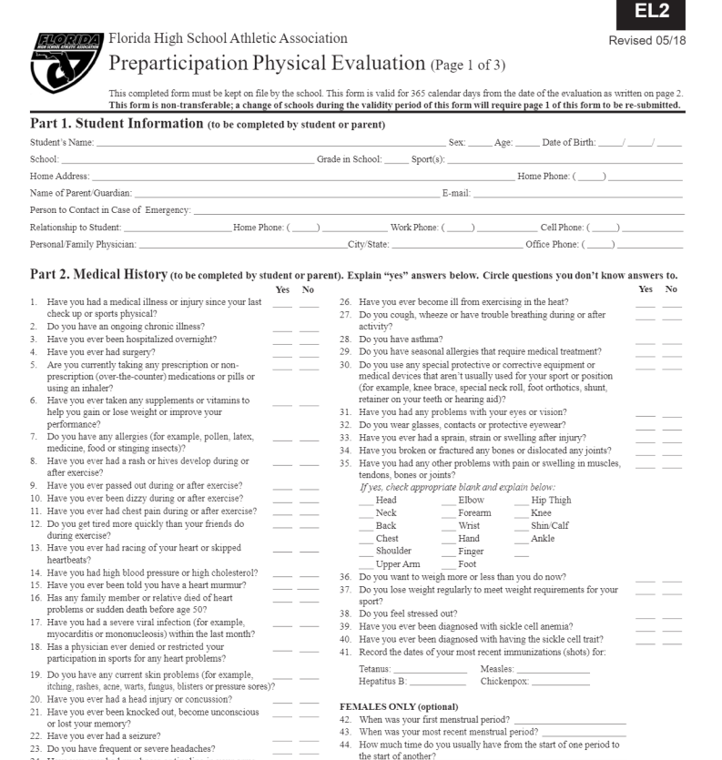
3. EL2 - Preparticipation Physical Evaluation (History Form)

Slide 9
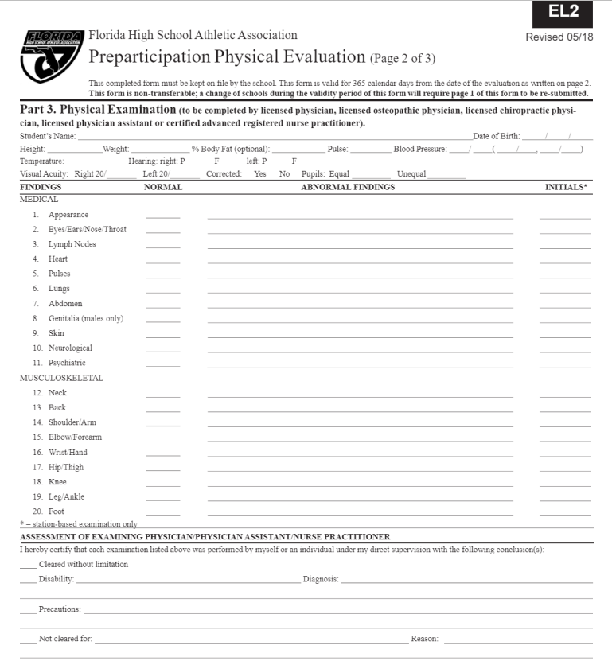
4. EL2 - Preparticipation Physical Evaluation (Physical Assessment)

Slide 10
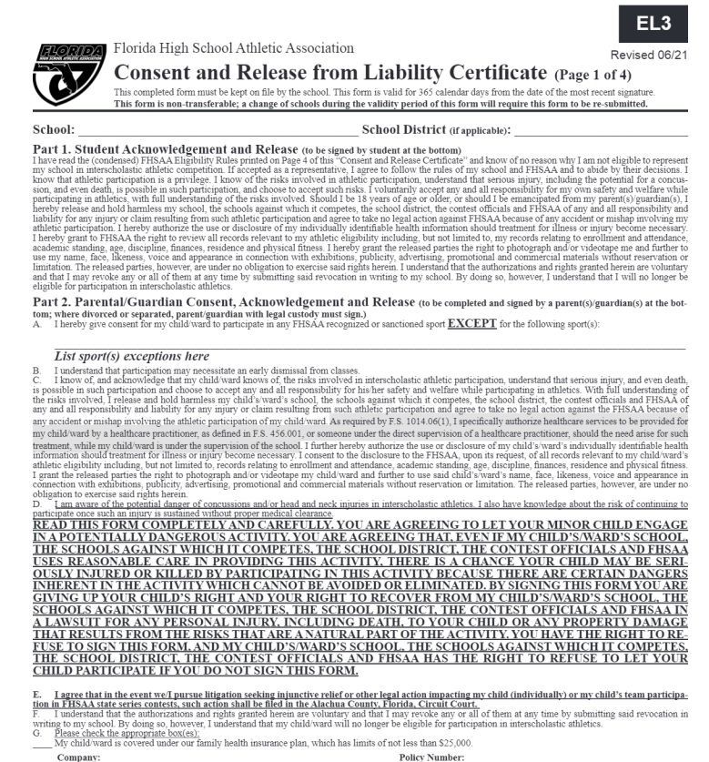
5. EL3 - Consent and Release from Liability Certificate

Slide 11
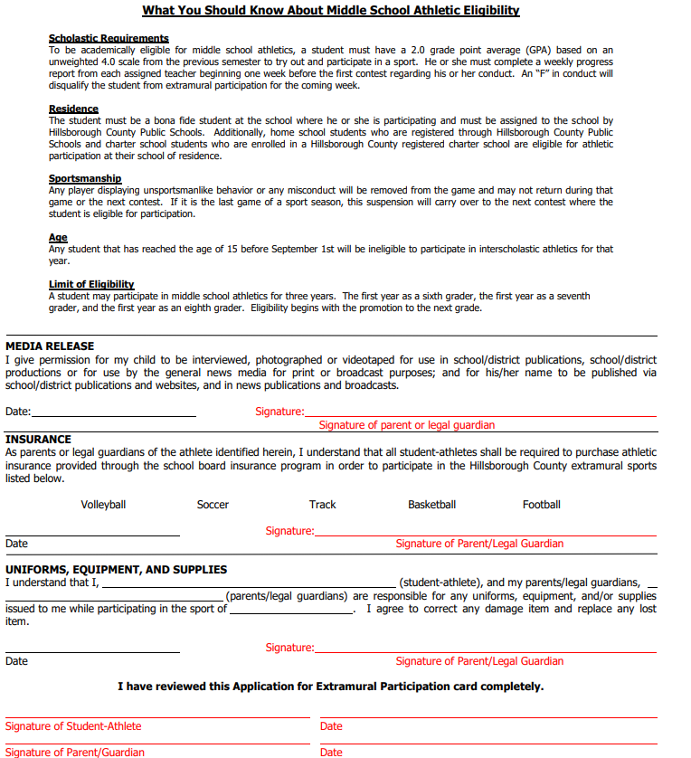
6. Middle School Athletic Eligibility Form

Slide 12
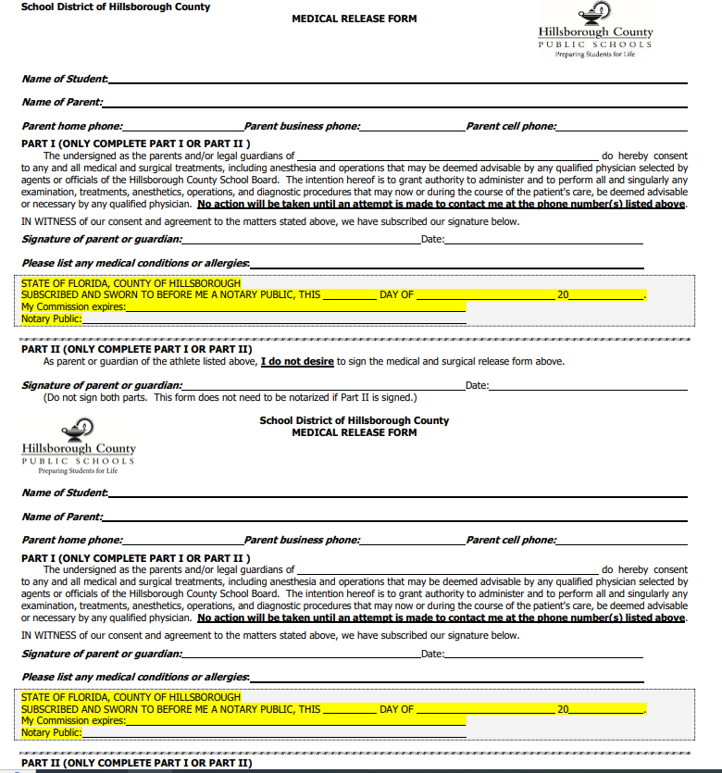
7. Medical Release Form

Slide 13
8. NFHS Learn Certificates
Follow the directions in the next slides to Create Account and get certificates.

Slide 14
As you are Completing forms to be submitted. You will also need to go to NFHS Learn | Interscholastic Education, Made Easy
At NFHSlearn.com Your child and Guardian Must watch 3 free Videos.
Heat Illness in sports
Concussions in Sports
Sudden Cardiac Arrest in Sports

Slide 15
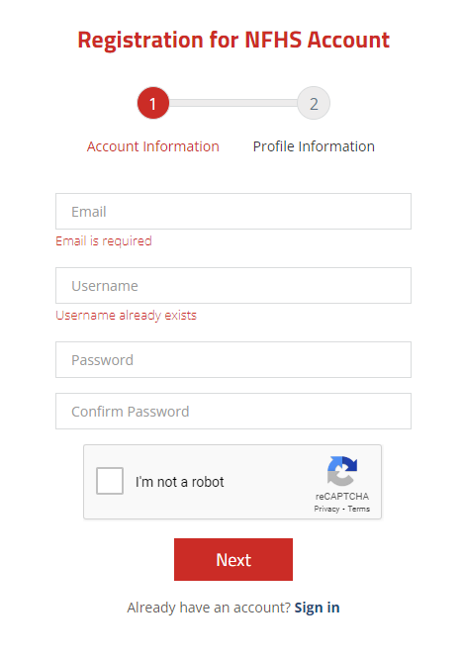
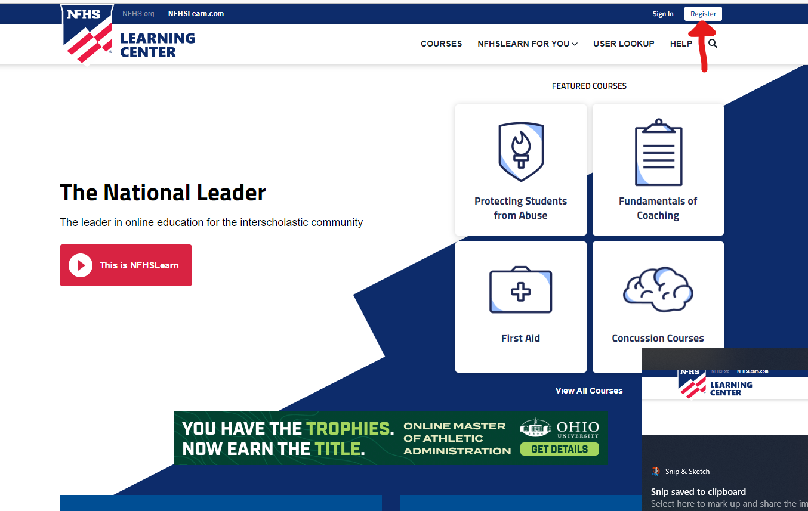
To register: Fill out

Slide 16
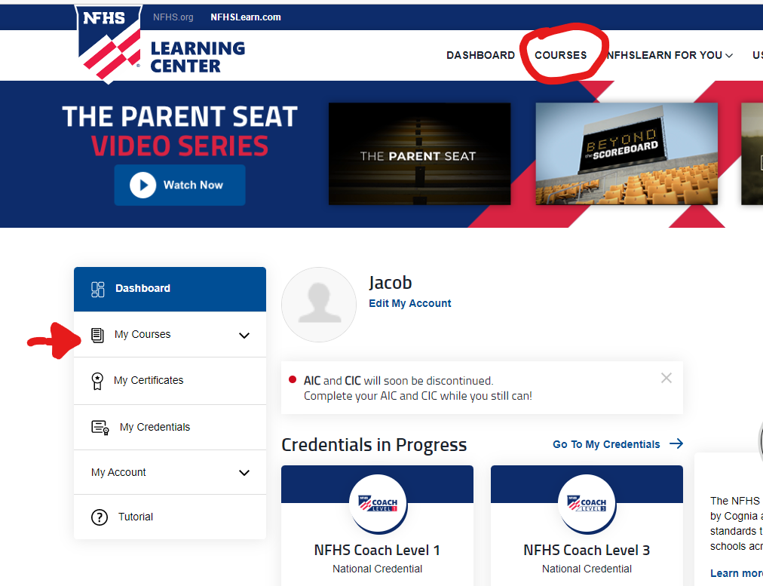
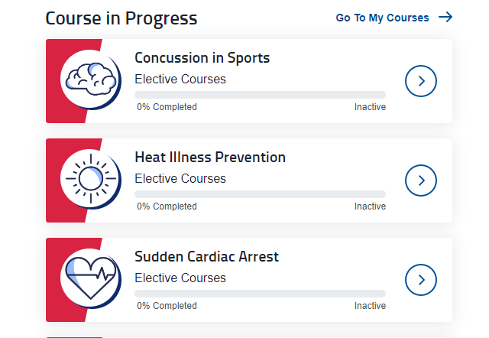
Once you are signed in, you will need to look for the 3 free courses and purchase them. No Credit card needed; they are FREE!

Slide 17
These 3 course need to be completed by the student and Guardian. At the End of each course, you will need Save the certificate as it is something you need to upload/submit online via Planet High School/ Big Teams

Slide 18
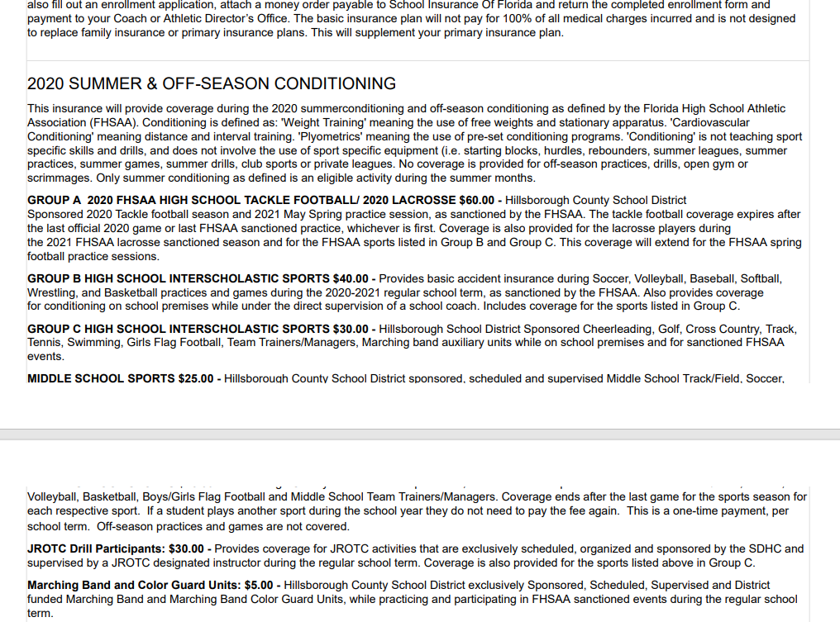
9. Excess Student Accident Insurance Overview

Slide 19
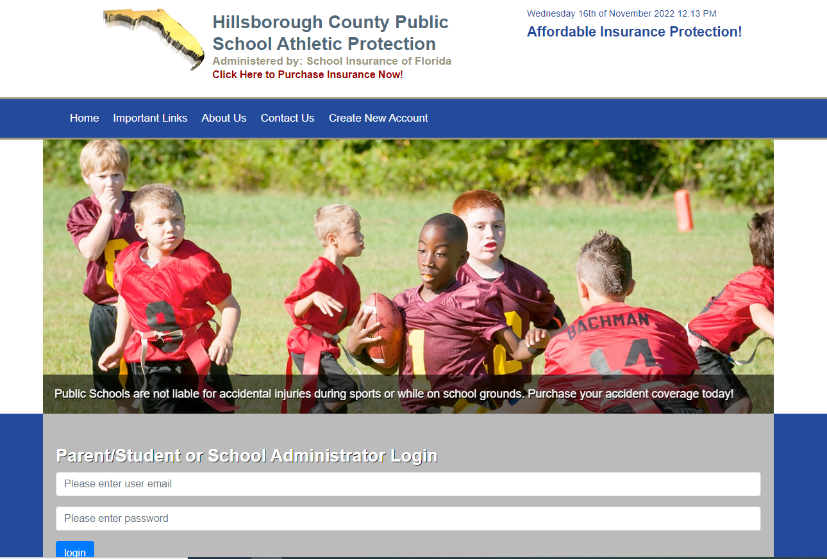
10. District Purchased Insurance (Mandatory) @ Hillsborough County Public School Athletic Protection | Student Insurance (hcpsathleticprotection.com)

Slide 20
11. Parent Government ID
That is an example of all forms needed and instructions on how to complete.
Again, Once everything is submitted Administration will approve and your child will be able to try out for any sport, they desire that School Year. Even if you did not check it off.
I hope this was helpful, And I hope you have a great year.

